Slide 1
systemic mycoses
Prepared by
Lecturer Reham M.M. AL-Mosawi
Medical Microbiology
Lec.Part 2

Slide 2
coccidioidomycosis histoplasmosis
blastomycosis paracoccidioidomycosis

Slide 3
Histoplasma capsulatum
Histoplasma capsulatum is a dimorphic soil saprophyte that causes histoplasmosis, the most prevalent pulmonary mycotic infection in humans and animals.
In nature, H capsulatum grows as a mold in association with soil and avian habitats,
H capsulatum and histoplasmosis, which is initiated by inhalation of the conidia, occur worldwide. However, the incidence varies considerably, and most cases occur in the United States.

Slide 4
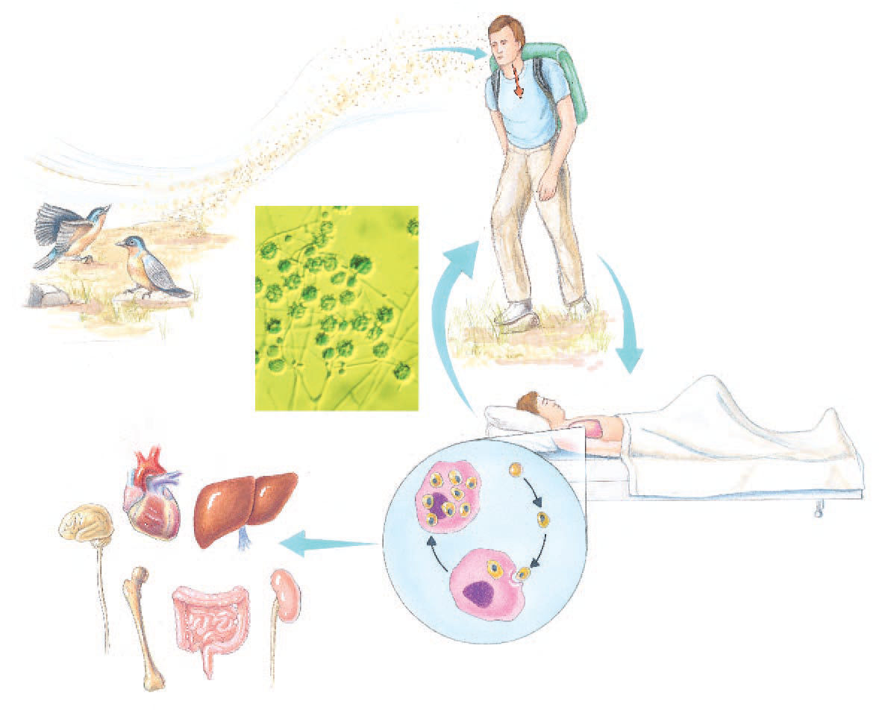
(b) Microconidia
are inhaled.
(a) Soil containing bird droppings
is whipped up by the wind.
Magnified view of
fungus spores in soil
(c) The patient develops mild
pneumonitis, which might recur.
d) In the tissue phase of infection, the yeast phase develops, is phagocytosed and multiplies by budding intracellularly. Most patients recover without complications,
.
(e) In some cases, phagocytes enter
the blood and cause disseminated disease
in a number of organs

Slide 5
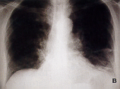
Systemic Mycosis: Histoplasmosis
Disseminated Histoplasma capsulatum, lung infection capsulatum, lung infection.

Slide 6
Morphology & Identification
At temperatures below 37 °C, primary isolates of H capsulatum often develop brown mold colonies, but the appearance varies. Many isolates grow slowly, and specimens require incubation for 4–12 weeks before colonies develop.
The hyaline, septate hyphae produce microconidia (2–5 m) and large, spherical thick-walled macroconidia with peripheral projections of cell wall material (8–16 m).
In tissue or in vitro on rich medium at 37 °C, the hyphae and conidia convert to small, oval yeast cells (2 x 4 m). In tissue, the yeasts are typically seen within macrophages, as H capsulatum is a facultative intracellular parasite .

Slide 7
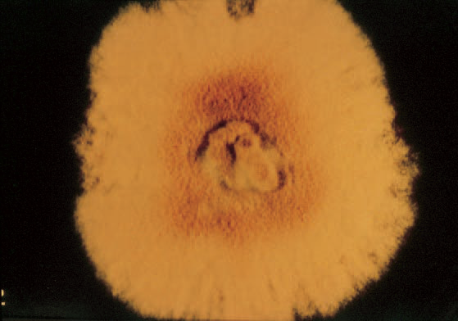
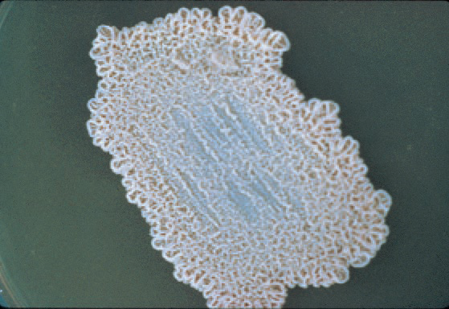
A colony at 25°C produces a fuzzy mycelium
A yeast colony (37°C) is dense and waxy

Slide 8
Antigenic Structure
Histoplasmin is a crude mycelial broth culture filtrate antigen. After initial infection, which is asymptomatic in over 95% of individuals, a positive delayed type skin test to histoplasmin is acquired. Antibodies to both yeast and mycelial antigens can be measured serologically

Slide 9
Diagnostic Laboratory Tests
Specimens
Specimens for culture include sputum, urine, scrapings from superficial lesions, bone marrow aspirates, and buffy coat blood cells. Blood films, bone marrow slides, and biopsy specimens may be examined microscopically. In disseminated histoplasmosis, bone marrow cultures are often positive.
Microscopic Examination
The small ovoid cells may be observed within macrophages in histologic sections stained with fungal stains (eg, Gomori's methenamine silver, periodic acid-Schiff, or calcofluor white) or in Giemsa-stained smears of bone marrow or blood.
Culture
Specimens are cultured in rich media, such as glucose-cysteine blood agar at 37 °C and on Sabouraud's agar or inhibitory mold agar at 25–30 °C. Cultures must be incubated for a minimum of 4 weeks

Slide 10
Thank you

